Slide 1

CHAPTER SIX
Exception Handling
By: Behayilu M.
Faculty of Computing and Software Engineering,
Arba Minch Institute of Technology(AMiT),
Arba Minch University

Slide 2
Points to be covered on this session
What is exception?
What is exception handling?
How to handle exception by using 5 keywords: try, catch, throw, throws and finally
Types of exception
How to create a user defined exception

Slide 3
Introduction to Exception
public class ExceptionExample1
{
public static void main(String args[])
{
int a=8;
int b=0;
int c=a/b;
System.out.println(c);
}
}
What happens when this method is used to divide a number by zero?
Program throws an Exception and fails
Exception in thread "main" java.lang.ArithmeticException: / by zero

Slide 4
What is an Exception?
An error event that disrupts the program flow and may cause a program to fail.
Some examples:
  Performing illegal arithmetic
  A user has entered invalid data
  Illegal arguments to methods
  Accessing an out-of-bounds array element
  Hardware failures
  Writing to a read-only file
"An exception was thrown" is the proper Java terminology for "an error happened."

Slide 5
Another Exception Example
What is the output of this program?
public class ExceptionExample2
{
public static void main(String args[])
{
String[] greek = {"Alpha", "Beta"};
System.out.println(greek[2]);
}
}
Output:
Exception in thread "main"
java.lang.ArrayIndexOutOfBoundsException: 2
at ExceptionExample2.main(ExceptionExample2.java:4)

Slide 6
Exception Message Details
Exception message format:
[exception class]: [additional description of exception]
at [class].[method]([file]:[line number])
Example:
java.lang.ArrayIndexOutOfBoundsException: 2
at ExceptionExample2.main(ExceptionExample2.java:4)
What exception class?
Which array index is out of bounds?
What method throws the exception?
What file contains the method?
What line of the file throws the exception?
ArrayIndexOutOfBoundsException
2
main
ExceptionExample2.java
4

Slide 7
What is Exception?
Exception is abnormal condition.
In java an Exception is an event that disrupts the normal flow of the program.
What is Exception handling?
The Exception Handling in Java is one of the most powerful mechanism to handle the run time errors so that the normal flow of the application can be maintained.
Exception handling is a mechanism to handle run time errors such as ClassNotFoundException, IOException, SQLException, RemoteException etc.

Slide 8
Advantage of Exception Handling
The core advantage of Exception handling is to maintain the normal flow of the application.
An Exception normally disrupts the normal flow of the application that is why we use Exception handling.

Slide 9
Exception Types
Throwable
Exception
Exception class is used for exceptional conditions that user programs should catch.
Exception of type RuntimeException are automatically defined for the programs that you write.
Error class defines exceptions that are not expected to be caught under normal circumstances.
Error
Runtime Exception

Slide 10
Uncaught Exceptions
When Java runtime system detects an exception
  It throws this exception.
  Once thrown it must be caught by an exception handler and dealt with immediately.
  If exception handling code is not written in the program , default handler of java catch the exception.
  The default handler displays a string describing the exception & terminates the program.

Slide 11
…cont’d
Handling exceptions by ourselves provides 2 benefits.
  First it allows you to fix the error.
  Second it prevents the program from automatically terminating.

Slide 12
…cont’d
A Java exception is an object that describes an exceptional (that is ‘error’) condition that has occurred in a piece of code at runtime.
When an exceptional condition arises, an object representing that exception is created and thrown in the method that caused the error.
That method may handle the exception itself, or pass it on.
Java exception handling is managed by 5 keywords: try, catch, throw, throws and finally.

Slide 13
Exception Handling
1. Use a try-catch block to handle exceptions that are thrown
The “try” keyword is used specify the a block where we should place exception code.
The try block must be followed by either catch or finally.
It means, we can’t use try block alone.
  try {
    // code that might throw exception
  }
  catch ([Type of Exception] e) {
    // what to do if exception is thrown
  }

Slide 14
2: The “catch” block is used to handle the exception.
It must be preceded by try block which means we can’t use catch block alone.
It can be followed by finally block later.
3: The “finally” block is used to execute the important code of the program.
It is executed whether an exception is handled or not.

Slide 15
Exception Handling Example1
public class Example{
public static void main(String args[])
{
int d,a;
try
{
d=0;
a=42/d;
}catch (ArithmeticException e) {
System.out.println(“Division by zero.");
}
}
}

Slide 16
…cont’d
Once an exception is thrown program control transfers to the try block from a catch.
Once the catch statement has executed, program control continues with the next line in the program following the entire try/catch mechanism.

Slide 17
Exception Handling Example2
public class ExceptionHandle2
{
Public static int average(int[] a) {
int total = 0;
for(int i = 0; i < a.length; i++) {
total += a[i];
}
return total / a.length;
}
Public static void printAverage(int[] a) {
try {
int avg = average(a);
System.out.println("the average is: " + avg);
}
catch (ArithmeticException e) {
System.out.println("error calculating average");
}
}
public static void main(String args[])
{
int a[ ]={2,6,4,5,6,7};
printAverage(a); // no exception
// int a[ ]={};
// printAverage(a); // exception
}
}

Slide 18
Catching Multiple Exceptions
Handle multiple possible exceptions by multiple successive catch blocks
  try {
  // code that might throw multiple exception
  }catch (IOException e) {
  // handle IOException and all subclasses
  }catch (ClassNotFoundException e2) {
  // handle ClassNotFoundException
  }
  Note: When an exception is thrown, each catch statement is inspected in order and the first one whose type matches that of the exception is executed. After one catch statement executes, the others are by passed, and execution continues after the try/catch block.

Slide 19
Exceptions Terminology
When an exception happens we say it was thrown or raised
When an exception is dealt with, we say the exception is was handled or caught

Slide 20
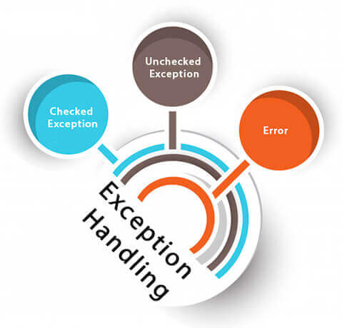
Types of Java Exceptions
There are mainly two types of exceptions: checked and unchecked.
Here, an error is considered as the unchecked exception.
According to Oracle, there are three types of exceptions:
Checked Exception
Unchecked Exception
Error

Slide 21
Unchecked Exceptions
All the exceptions we've seen so far have been Unchecked Exceptions, or Runtime Exceptions.
The classes which inherit RuntimeException are known as unchecked exceptions.
Usually occur because of programming errors, when code is not robust enough to prevent them.
They are numerous and can be ignored by the programmer.

Slide 22
Common Unchecked Exceptions
NullPointerException
reference is null and should not be
IllegalArgumentException
method argument is improper is some way
ArithmeticException and
/ by zero
ArrayIndexOutOfBoundsException etc.

Slide 23
Checked Exceptions
The classes which directly inherit Throwable class except RuntimeException and Error are known as checked exceptions.
E.g. IOException, SQLException, etc.
Checked exceptions are checked at compile time.
They are less frequent and they cannot be ignored by the programmer.

Slide 24
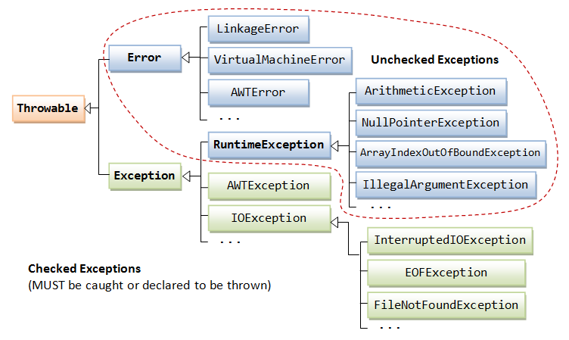
Exception Class Hierarchy
All exceptions are instances of classes that are subclasses of Throwable

Slide 25
Dealing With Checked Exceptions
Every method must catch (handle) checked exceptions or specify that it may throw them
Specify with the throws keyword
void readFile(String filename) {
try {
FileReader reader = new FileReader("myfile.txt");
// read from file . . .
} catch (FileNotFoundException e) {
System.out.println("file was not found");
}
}
void readFile(String filename) throws FileNotFoundException {
FileReader reader = new FileReader("myfile.txt");
// read from file . . .
}
or

Slide 26
4: Throw
The throw keyword in Java is used to explicitly throw an exception from a method or any block of code.
We can throw either checked or unchecked exception.
The throw keyword is mainly used to throw custom exceptions.
5: Throws
The throws keyword is used to declare exceptions.
It doesn’t throw an exception.
Throws is used in the signature of method to indicate that this method might throw one of the listed type exceptions.

Slide 27
Throw Example
Throw exception with the throw keyword
public static int average(int[] a)
{
if (a.length == 0)
{
throw new IllegalArgumentException("array is empty");
}
int total = 0;
for(int i = 0; i < a.length; i++)
{
total += a[i];
}
return total / a.length;
}
Notes:
Ask Class: Is IllegalArgumentException checked or unchecked?

Slide 28
Throws example
public class ThrowsExample
{
int division(int a, int b) throws ArithmeticException{
int t = a/b;
return t;
}
public static void main(String args[]){
ThrowsExample obj = new ThrowsExample();
try{
System.out.println(obj.division(15,0));
}catch(ArithmeticException e){
System.out.println("You shouldn't divide number by zero");
}
}
}

Slide 29
Throw vs Throws
Throws clause is used to declare an exception, which means it works similar to the try-catch block. On the other hand throw keyword is used to throw an exception explicitly.
Throw is followed by an instance of Exception class and throws is followed by exception class names.
Throw keyword is used in the method body to throw an exception, while throws is used in method signature to declare the exceptions that can occur in the statements present in the method.

Slide 30
Checked and Unchecked Exceptions
Checked Exception | Unchecked Exception
not subclass of RuntimeException | subclass of RuntimeException
if not caught, method must specify it to be thrown | if not caught, method may specify it to be thrown
for errors that the programmer cannot directly prevent from occurring | for errors that the programmer can directly prevent from occurring,
IOException, FileNotFoundException, SocketException | NullPointerException, IllegalArgumentException, IllegalStateException

Slide 31
Difference between throw and throws
No. | throw | throws
1. | Java throw keyword is used to explicitly throw an exception. | Java throws keyword is used to declare an exception.
2. | Throw is followed by an instance. | Throws is followed by class.
3. | Throw is used within the method. | throws is used with the method signature.
4. | You cannot throw multiple exceptions. | You can declare multiple exceptions e.g. public void method() throws IOException, SQLException.

Slide 32
Java Custom Exception
Creating our own Exception is known as custom exception or user-defined exception.
Basically, Java custom exceptions are used to customize the exception according to user need.
Using the custom exception, we can have your own exception and message.

Slide 33
Java Custom Exception
Example 1:
Let's see a simple example of Java custom exception.
In the following code, constructor of InvalidAgeException takes a string as an argument.
This string is passed to constructor of parent class Exception using the super() method.
Also the constructor of Exception class can be called without using a parameter and calling super() method is not mandatory.

Slide 34
package pack;
// class representing custom exception
class InvalidAgeException extends Exception {
public InvalidAgeException (String str) {
// calling the constructor of parent Exception
super(str);
}
}
// class that uses custom exception InvalidAgeException
public class TestCustomException1 {
// method to check the age
static void validate (int age) throws InvalidAgeException{
if(age < 18){
// throw an object of user defined exception
throw new InvalidAgeException("age is not valid to vote");
}
else {
System.out.println("welcome to vote");
}
}
public static void main(String args[]) {
try {
validate(13);
}
catch (InvalidAgeException ex) {
System.out.println("Caught the exception");
System.out.println("Exception occured: " + ex);
}
System.out.println("rest of the code...");
}
}

Slide 35
Keyword Summary
Four new Java keywords
try and catch – used to handle exceptions that may be thrown
throws – to specify which exceptions a method throws in method declaration
throw – to throw an exception

